Slide 1
CIHA 2016 Session 18: Media and Visuality
Rooted and Routed: The Worlding of Contemporary Indigenous Art
Elaine O’Brien, California State University, Sacramento
Reader: Ann Albritton, Ringling College of Art & Design, Sarasota, Florida

Slide 2
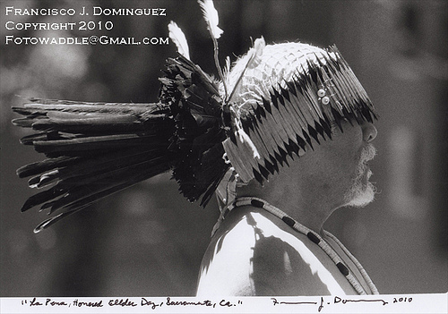
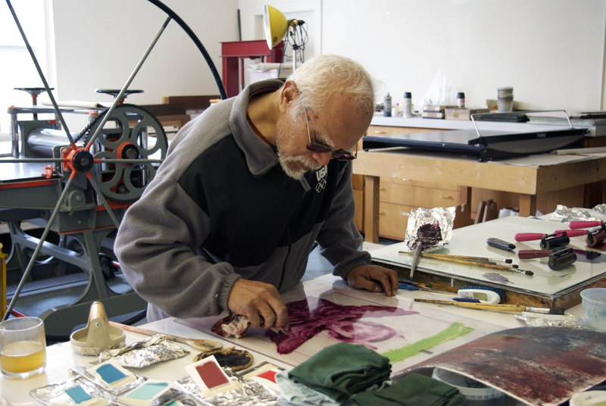
Frank LaPena (Wintu-Nomtipom-Filipino b.1937, San Francisco)

Slide 3
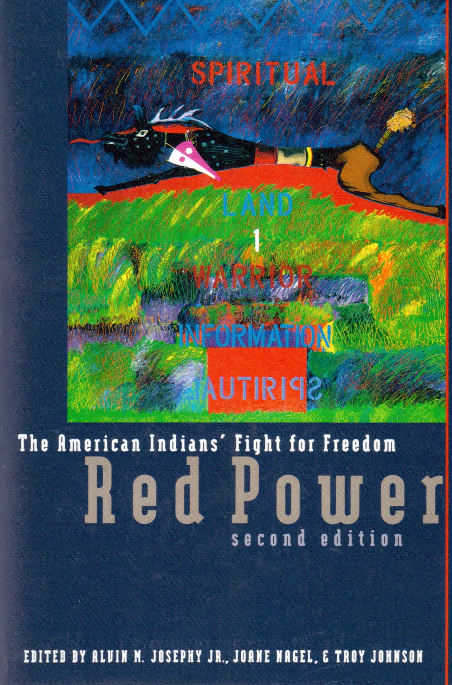
The Red Power Indian activist movement (1969-1978) - a Pan-Indian movement uniting “Indians of All Tribes” in North America

Slide 4
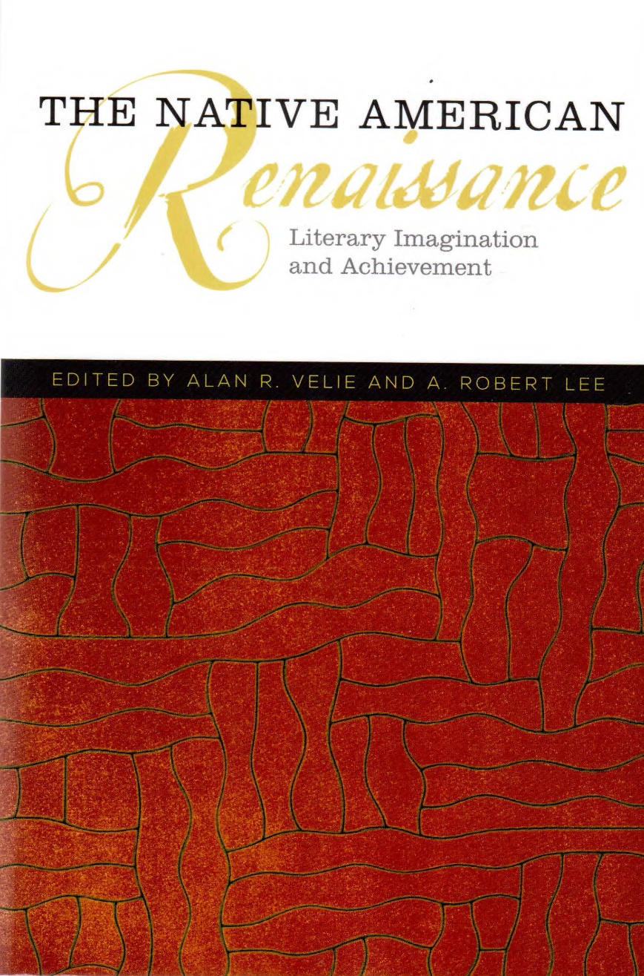
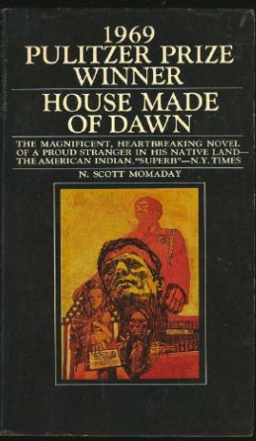
(left) A 2013 collection of essays on the surge of post-colonial Native American writing after 1968, when N. Scott Momaday’s Pulitzer Prize-winning House Made of Dawn (above) was published.

Slide 5
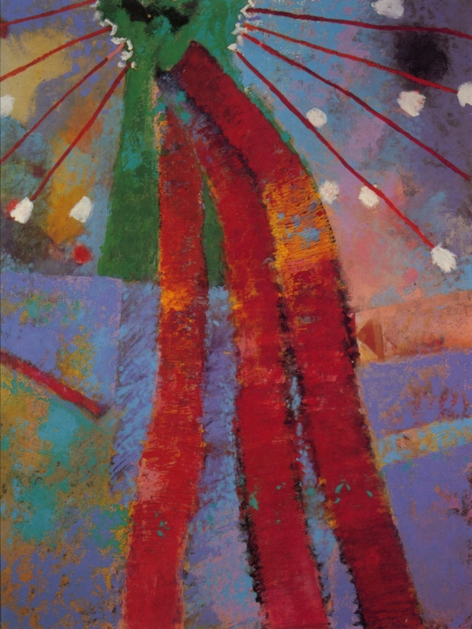
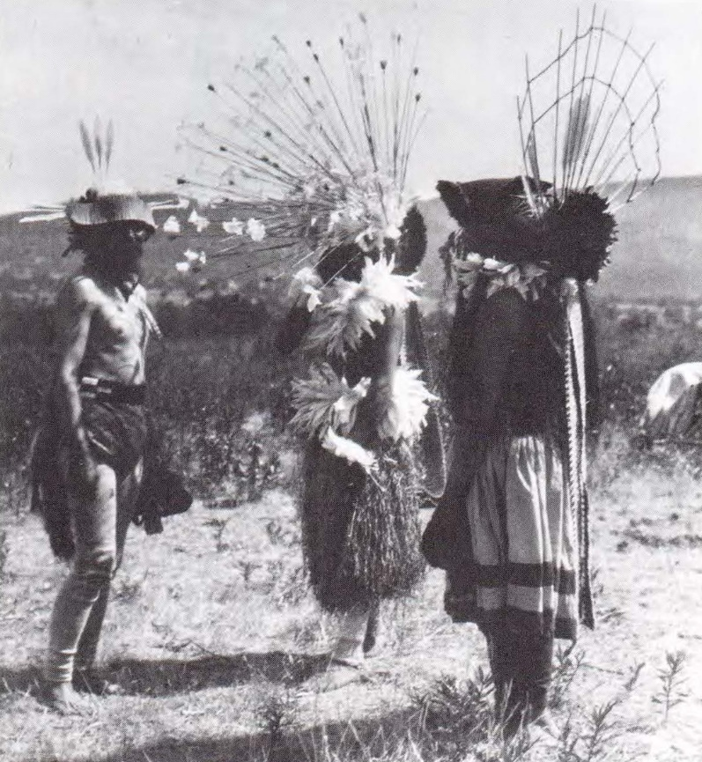
Hesi Dancers near Chico, California,1907
“The non-Indian viewer will see it as abstract painting, contemporary art.”
- Frank LaPena
Frank LaPena, Dance Spirit, 1981, Acrylic on canvas

Slide 6
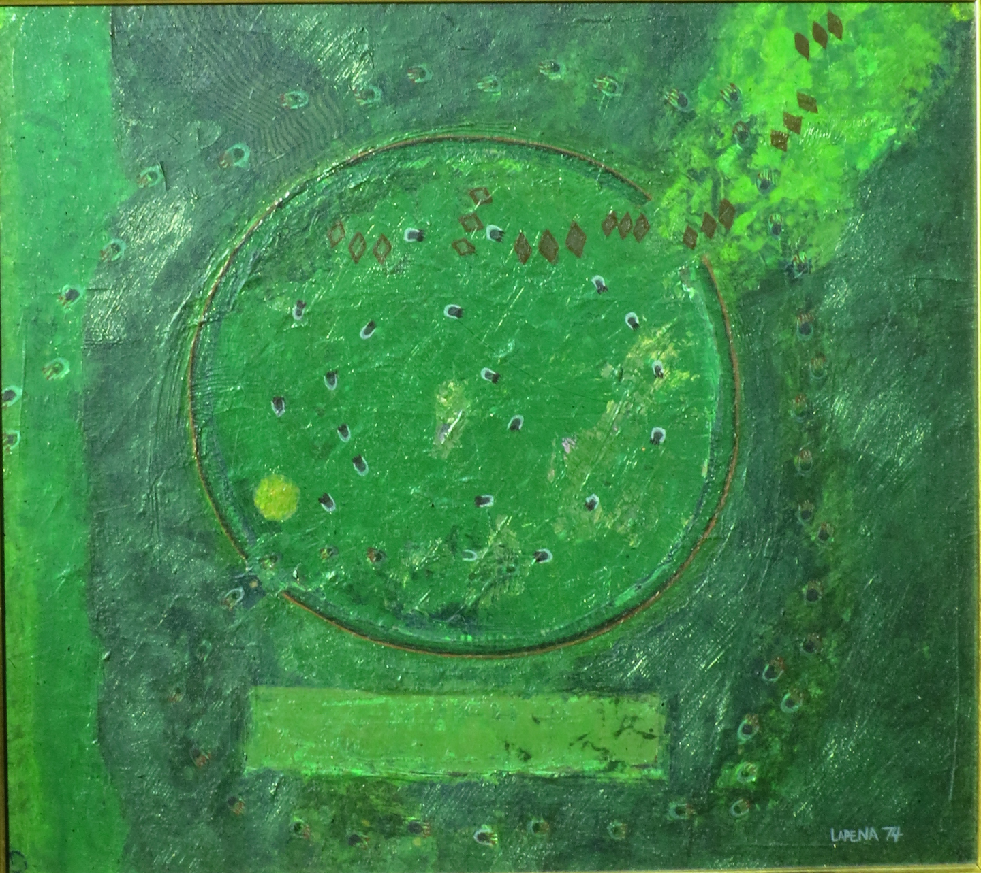
Frank LaPena, Spring Bear Dance and Whirlwind, acrylic on canvas, 1974, 24 x 24 in.

Slide 7
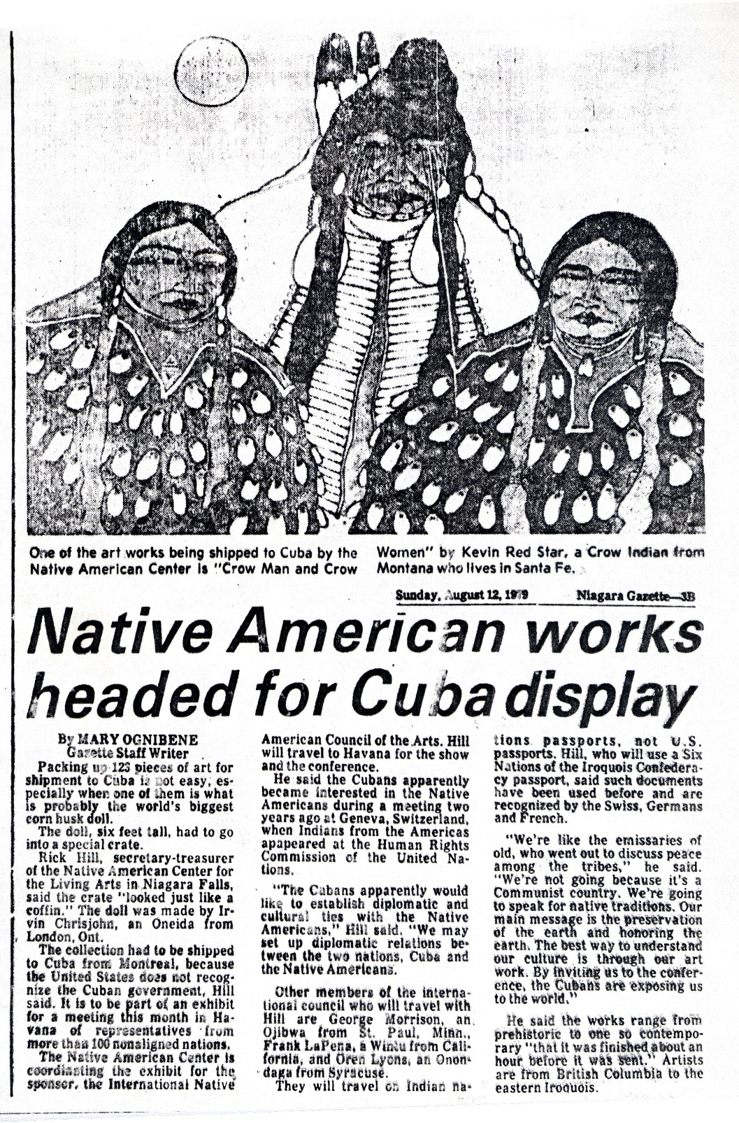
In 1979 LaPena traveled to Cuba as a member of the International Native American Council of the Arts for an exhibition in Havana for a meeting of representatives of more than 100 nonaligned nations.

Slide 8
Frank LaPena, Spring Bear Dance and Whirlwind, acrylic on canvas, 1974, 24 x 24 in.

Slide 9
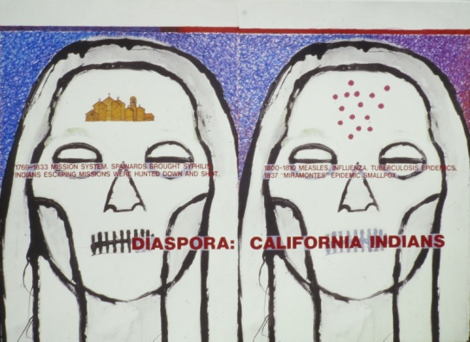
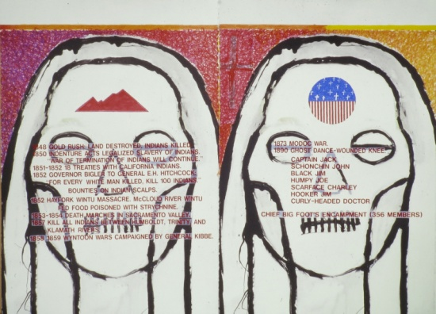
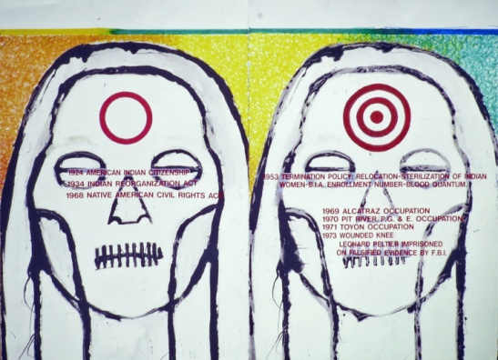
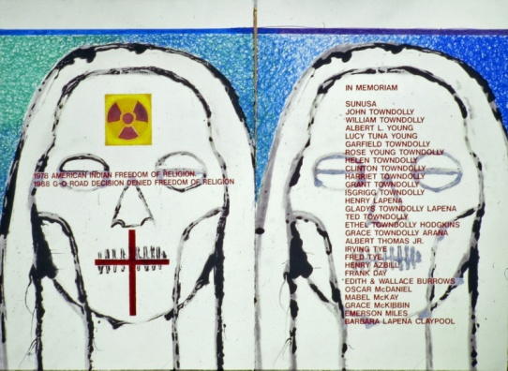
Frank LaPena, Diaspora: California Indians, mixed-media mural on paper, 8 panels, each 19 x 28 in, 1999, for Ceremonial, an official collateral exhibition of eight Native American artists at the 48th Venice Biennale.

Slide 10
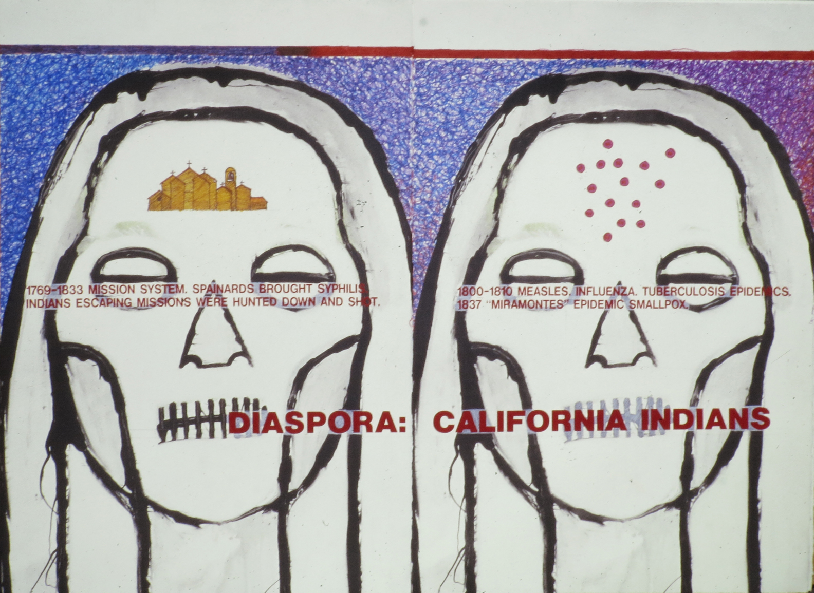

Slide 11


Slide 12


Slide 13


Slide 14
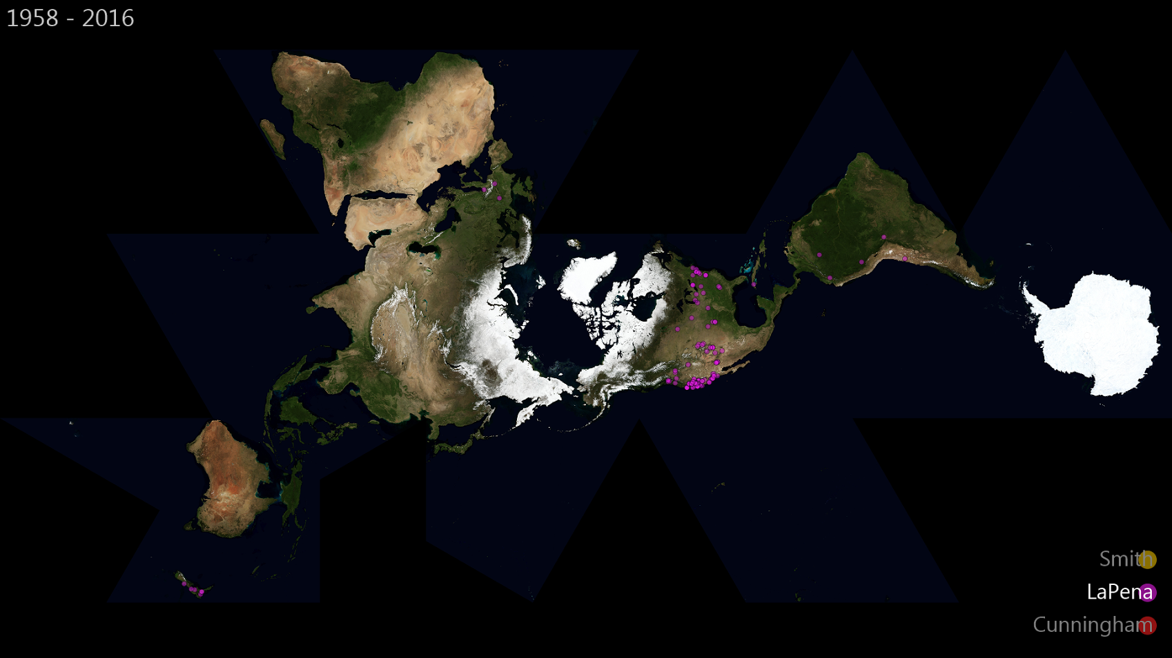

Slide 15
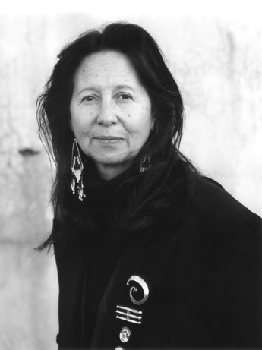
Jaune Quick-to-See Smith
Salish (Sqelix’u), b. 1940

Slide 16
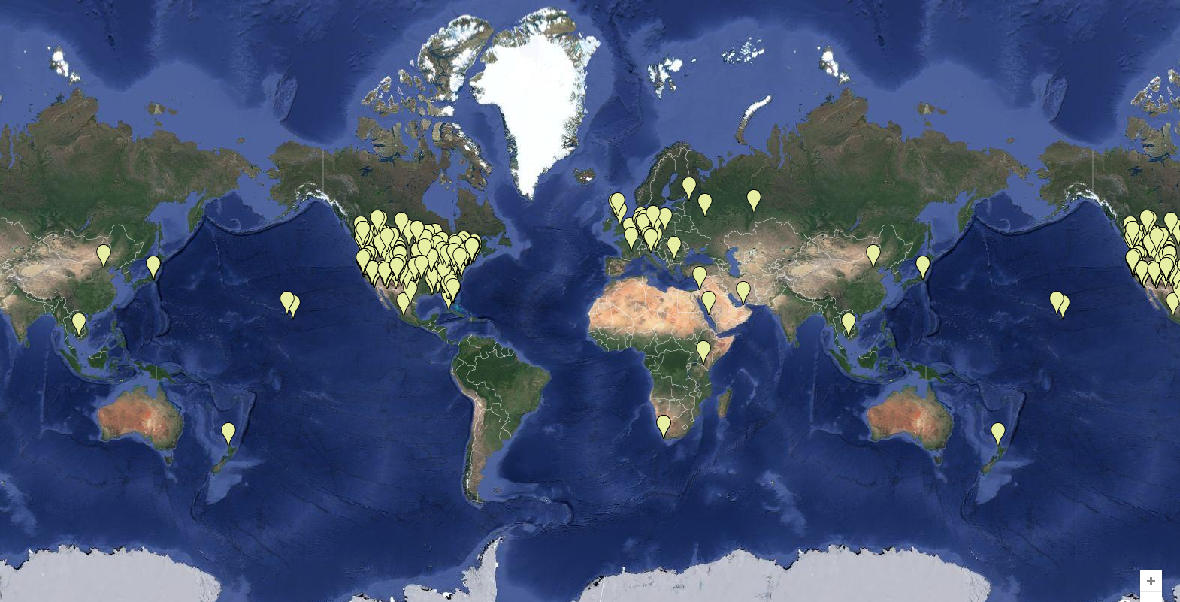

Slide 17
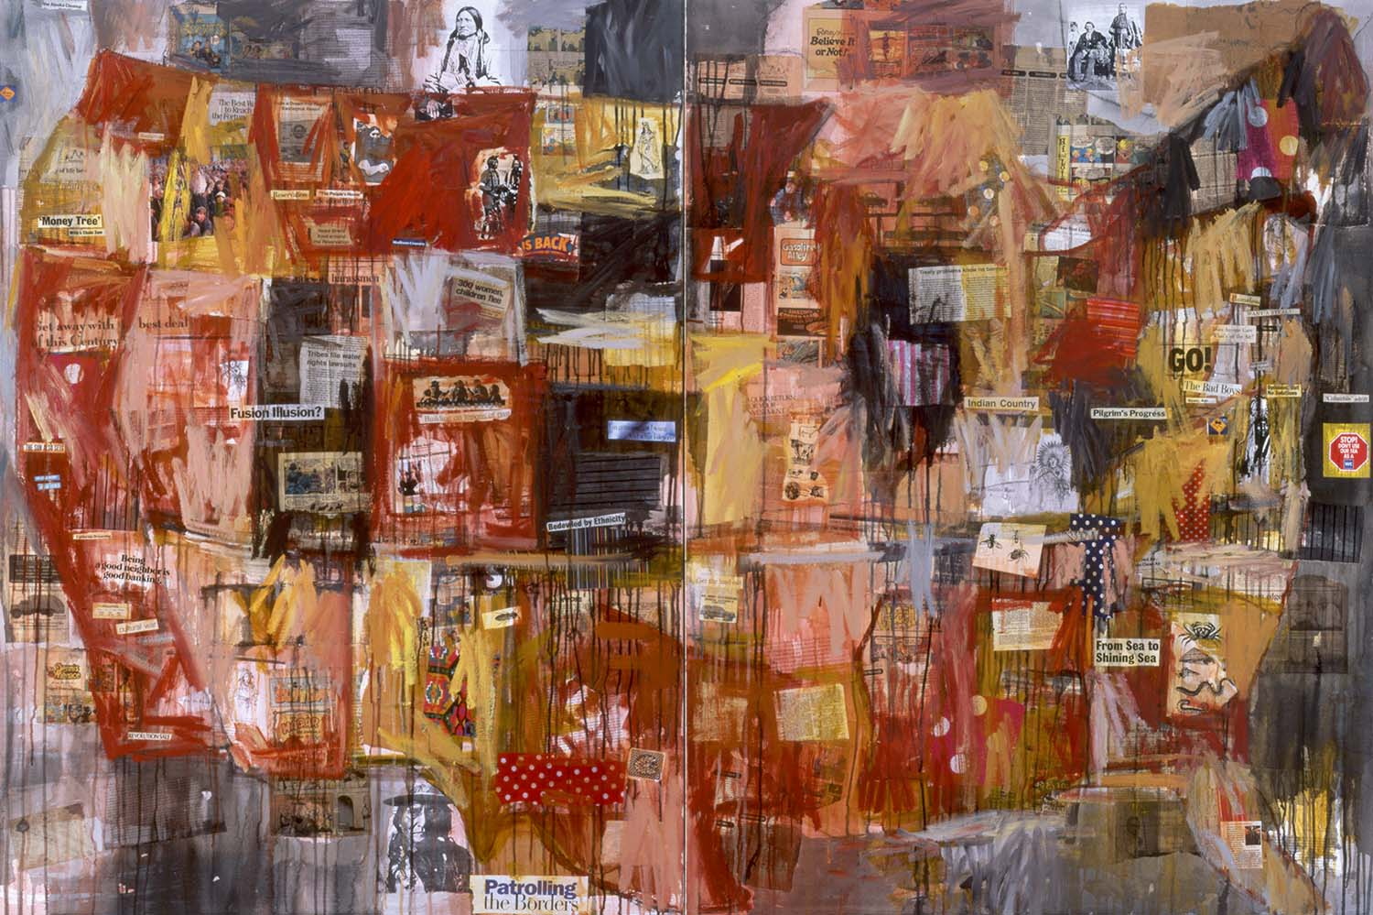
Jaune Quick-to-See Smith, Indian Map, 1992, mixed-media painting on canvas

Slide 18
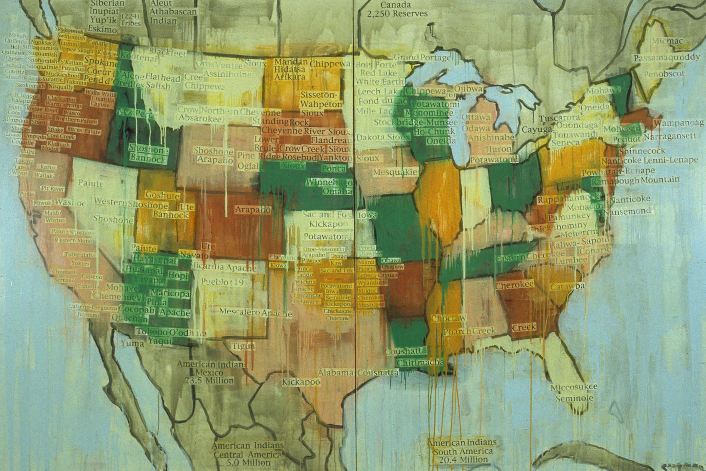
Jaune Quick-to-See Smith, Tribal Map, 2000, mixed-media painting on canvas

Slide 19
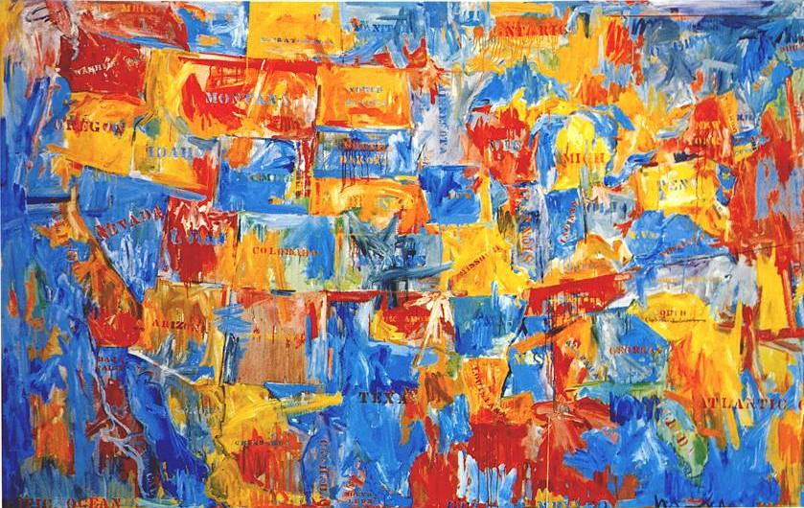
Jasper Johns, Map, 1961, oil on canvas

Slide 20
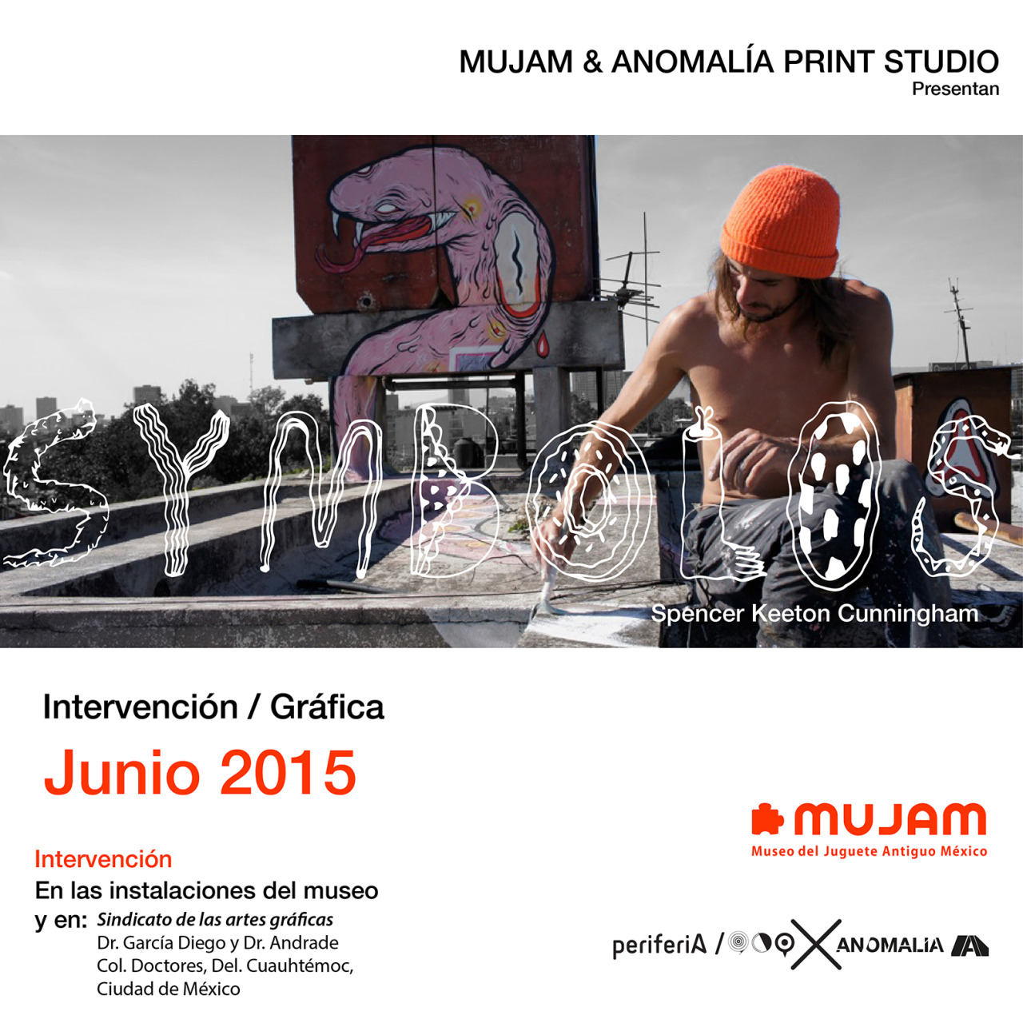
Spencer Keeton Cunningham
(Colville, 1983)

Slide 21
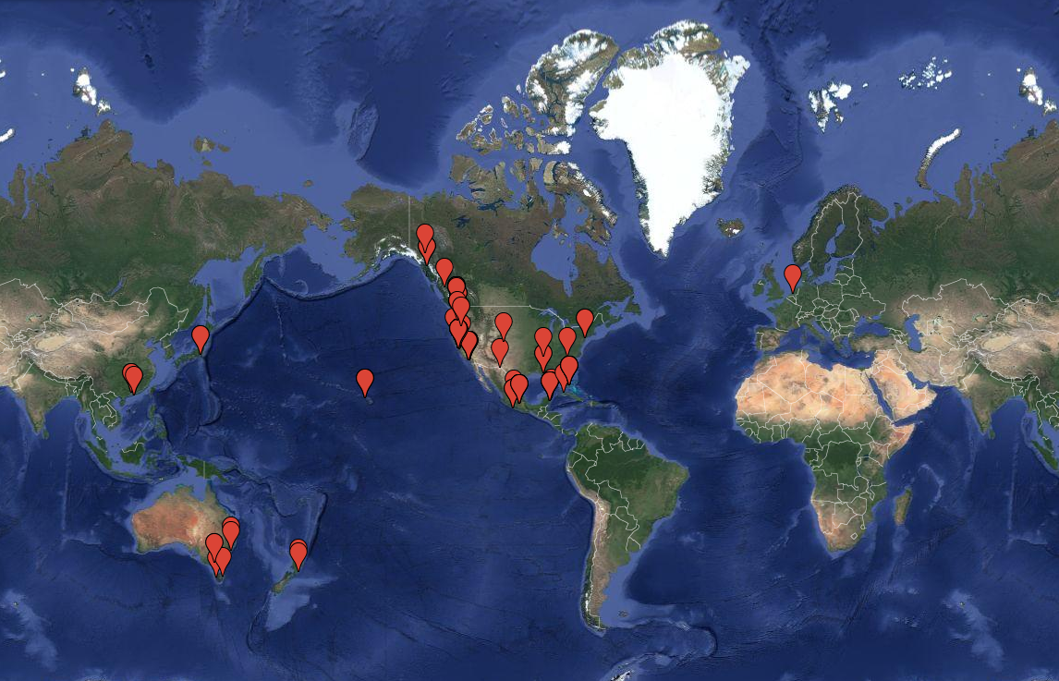

Slide 22
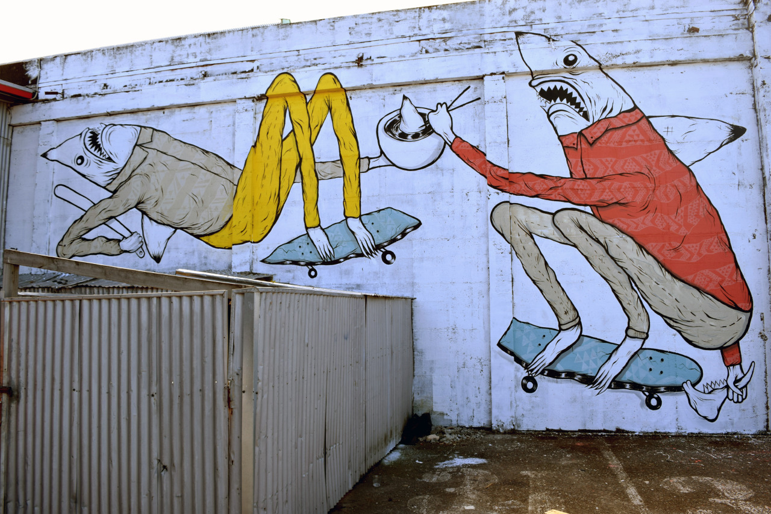
Spencer Keeton Cunningham, Shark Fin Soup: New Zealand, public mural, 2015

Slide 23
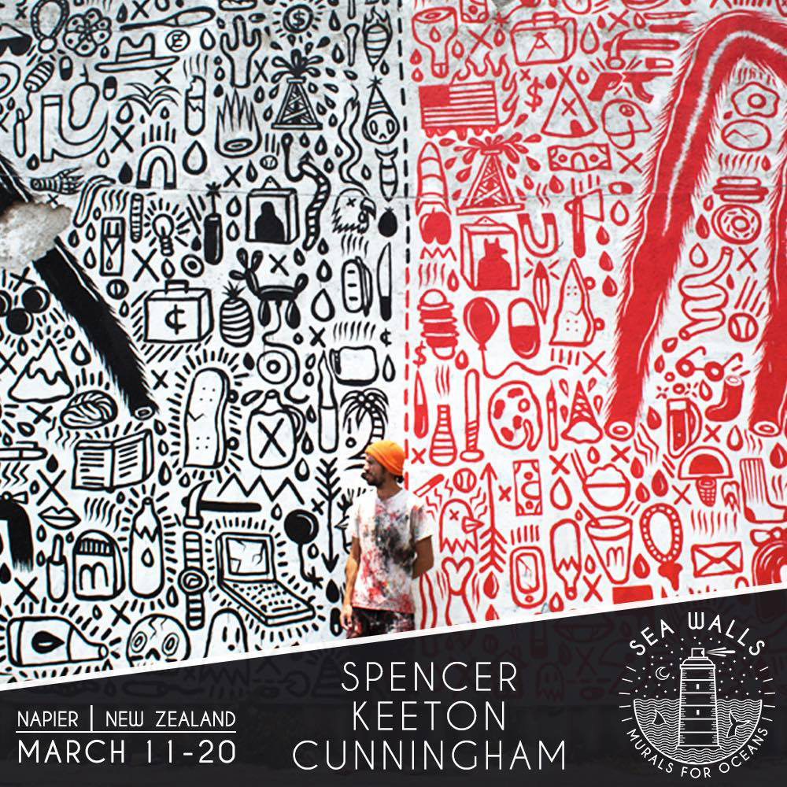

Slide 24
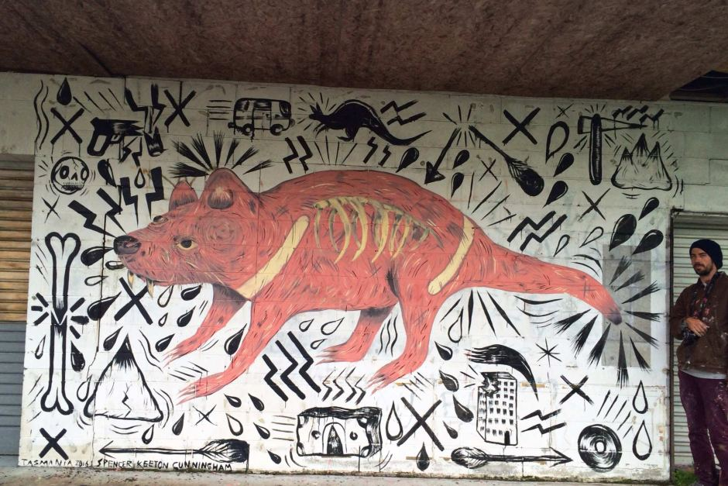
Spencer Keeton Cunningham, Tasmanian Devil: Tasmania, Public mural, 2016

Slide 25
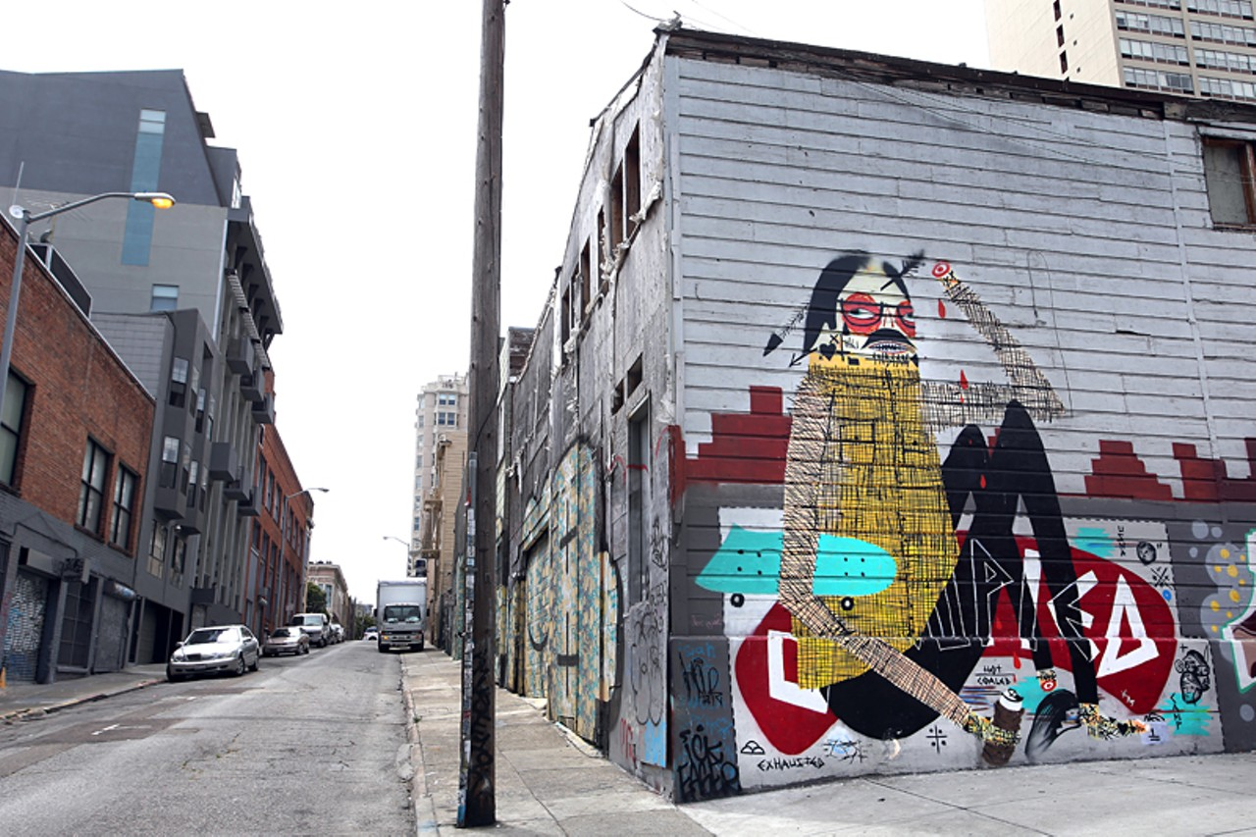
Spencer Keeton Cunningham and Jaque Fragua, American Indian Occupation: San Francisco, Public mural, 2011

Slide 26
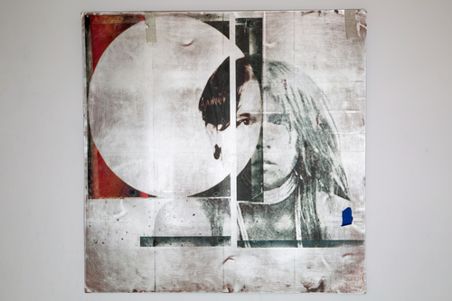
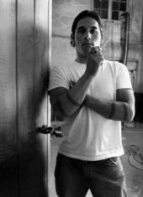
Richard Bluecloud Castaneda, Historical Selfie

Slide 27
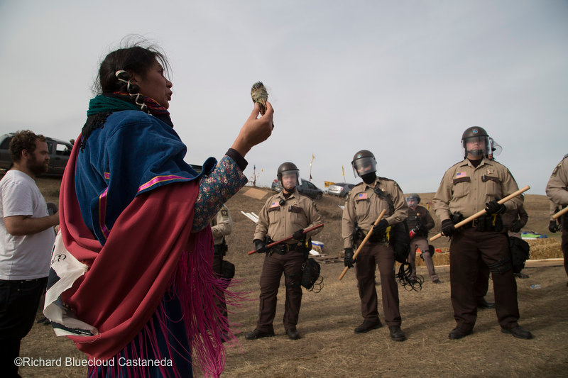

Slide 28
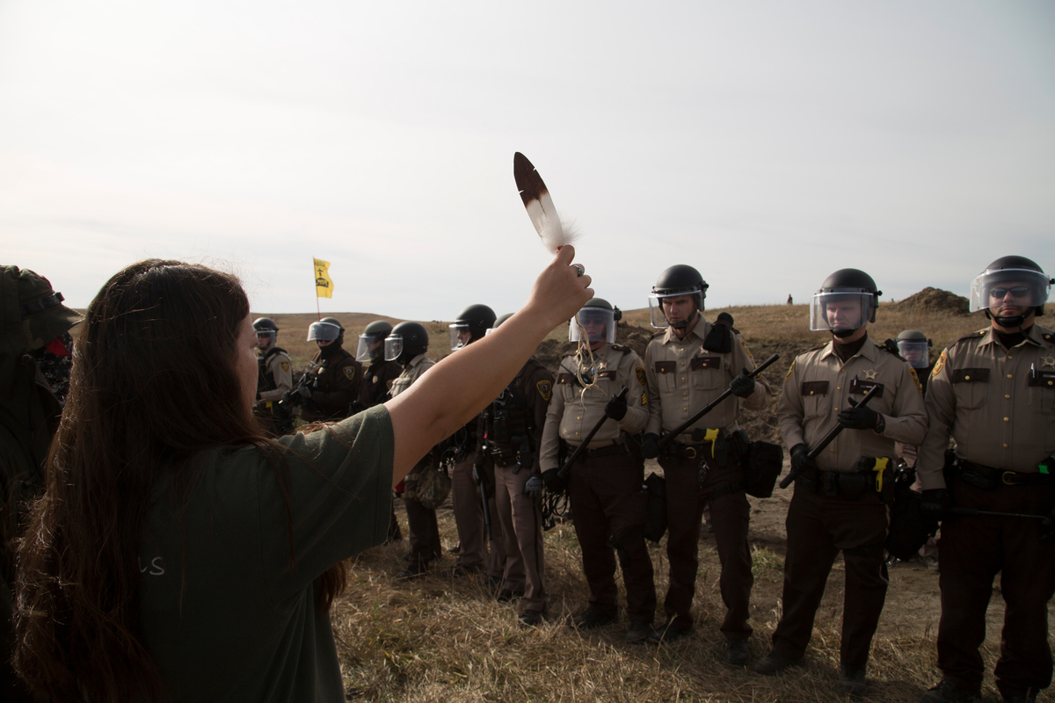
A phalanx of National Guard and police advance toward a water protector holding an eagle feather at a camp near the Standing Rock Reservation in the direct path of the Dakota Access pipeline.

Slide 29
